Slide 1
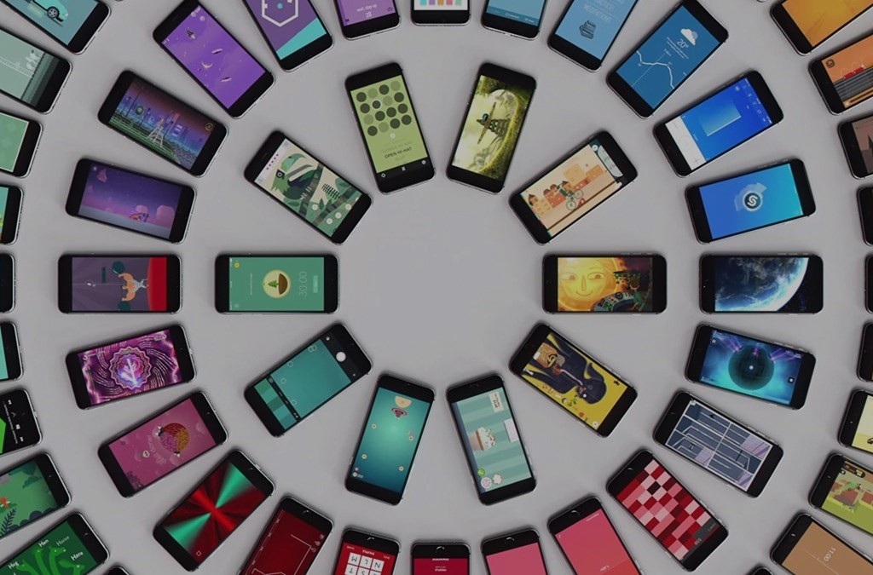
MOBILE DEVICES ANALYSIS
Predicting the cost of a mobile device based on it's hardware.
Chen Yakov & Shimon Kalderaro

Slide 2
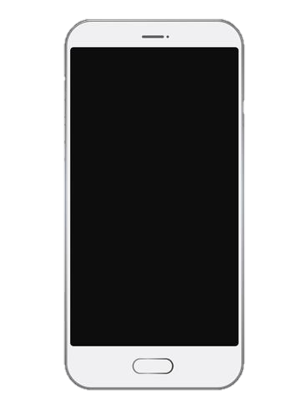
Main Steps
Acquiring data by scraping the web via selenium
Research question
Data handling
Machine Learning
EDA
Conclusions

Slide 3

Research Question
Is it possible to predict the price of a new phone based on its hardware components?

Slide 4
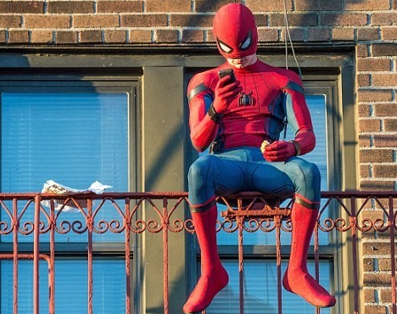
Crawling and data acquisition

Slide 5
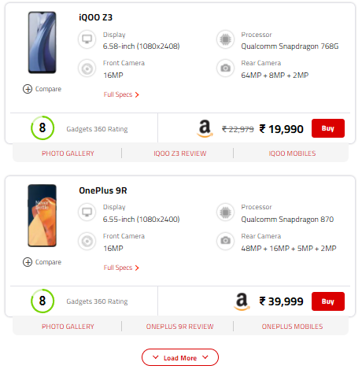
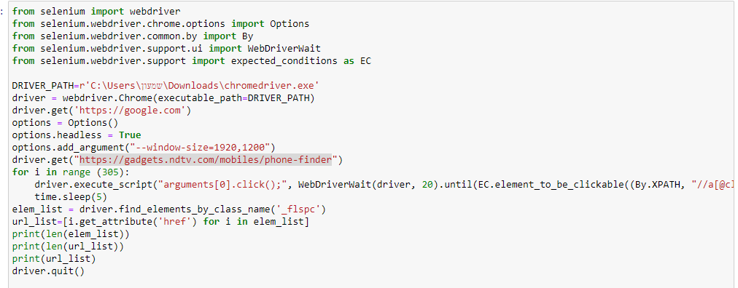
We used selenium to crawl out data.
We split the crawling procedure to 2 steps:
In the first step, we collected the URL links
from each device and saved it into python list.
Each page has 20 mobile devices, so after
every 20 devices, we have to “click” the load
more CSS script.

Slide 6
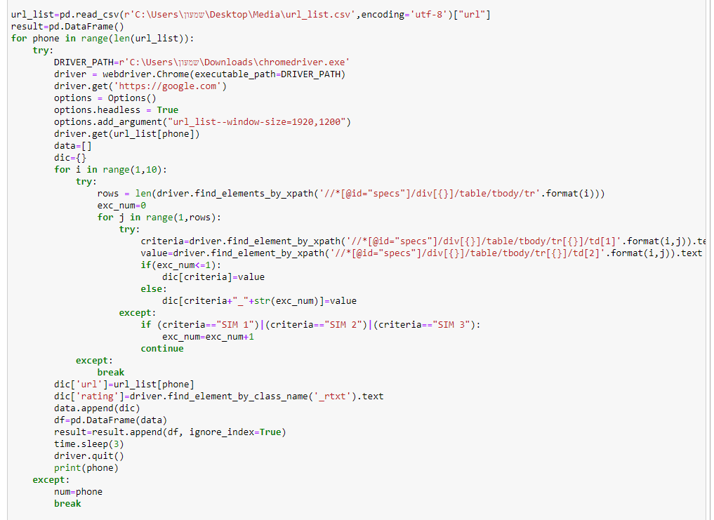
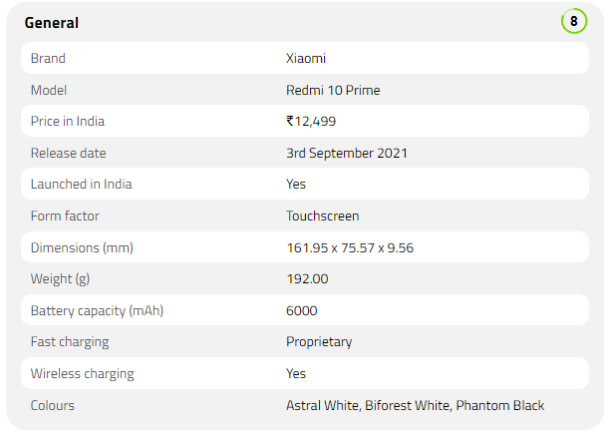
In the second step, we visited every URL link
from the list that we got from the first step.
Every instance of mobile device, have a
few properties tables, we got our
information from those tables, by exploring
the HTML code of the website.
We noticed that the amount of tables
changed between every instance, and we
solved that by try and except command.

Slide 7
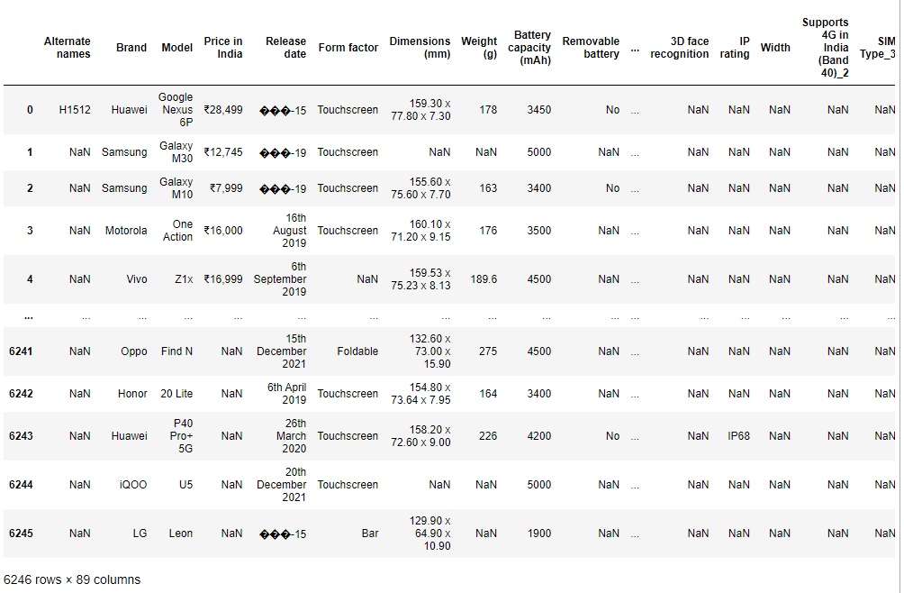
The data frame we got after crawling looks like this

Slide 8

Some important points!
We imported the selenium libraries to out project
We crawled all the data from the website: https://gadgets.ndtv.com/mobiles/phone-finder
We explored the HTML code of the sites that we used
The procedure of the first step took 2 hours and the procedure of the second step took a few days
Between every instance of phone, we did time.sleep of 5 seconds
After we finished with the crawling, we Imported the information to a CSV file

Slide 9


Cleaning and Fixing the Data

Slide 10
Data Handling
In the raw data frame, we had up to 6100 rows and 90 columns(549,000 cells of information).
We figure out that a lot of columns are fill only by few rows, so we dropped them.
we dropped All the rows that missed more than 7 columns .
After all the dropping we stay with 4161 rows and 43 columns, but we still had some missing data.
All the data was in string, so we used text analysis to extract the data that we needed from
each attribute.
We modified the type of each attribute.
We splited the processor column to 2 columns(processor frequency and num of cores).
We fill the missing data with the mode, median, mean values.
We used graphic way and z_ score to detect and drop outliers

Slide 11
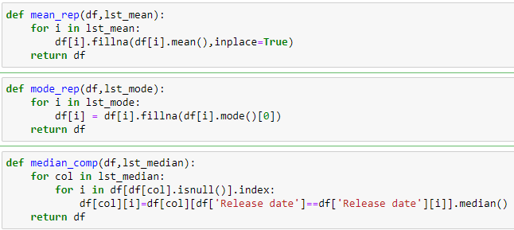
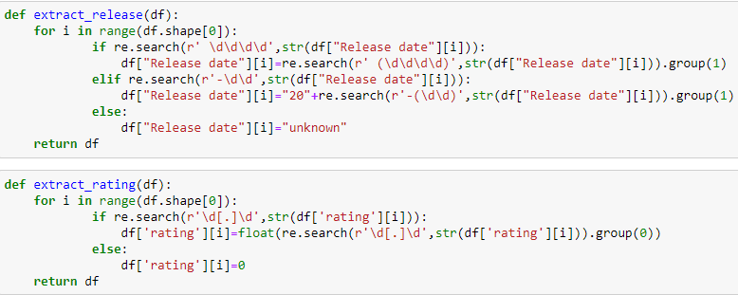
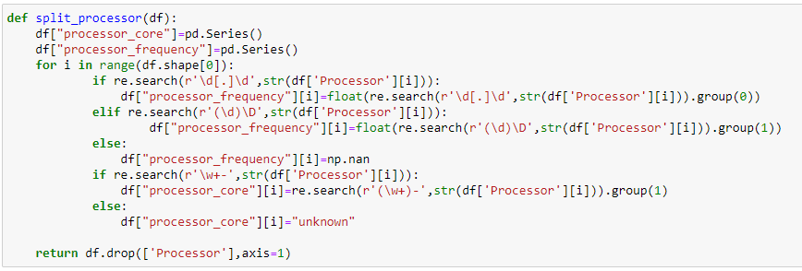
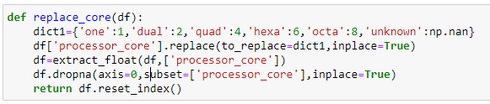

Slide 12
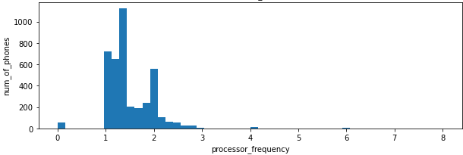
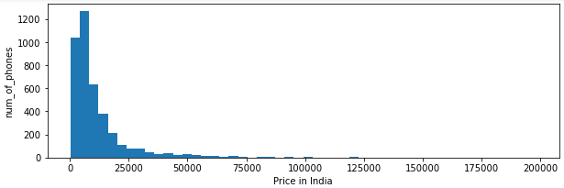
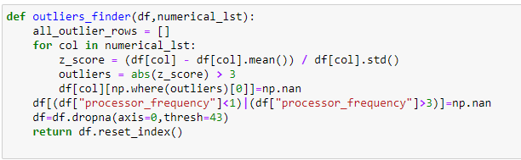
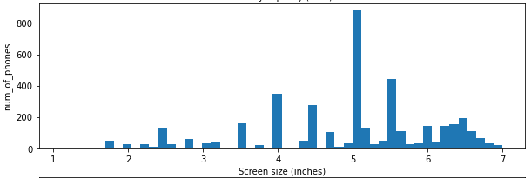
Outliers

Slide 13
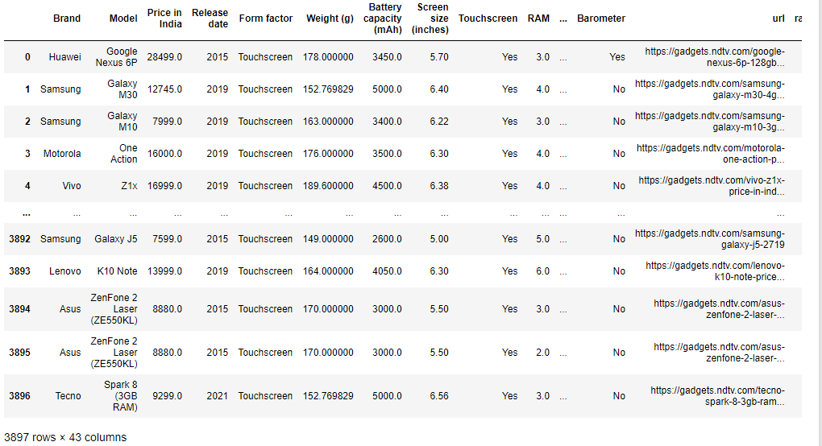
The data frame after all the cleaning and fixing

Slide 14
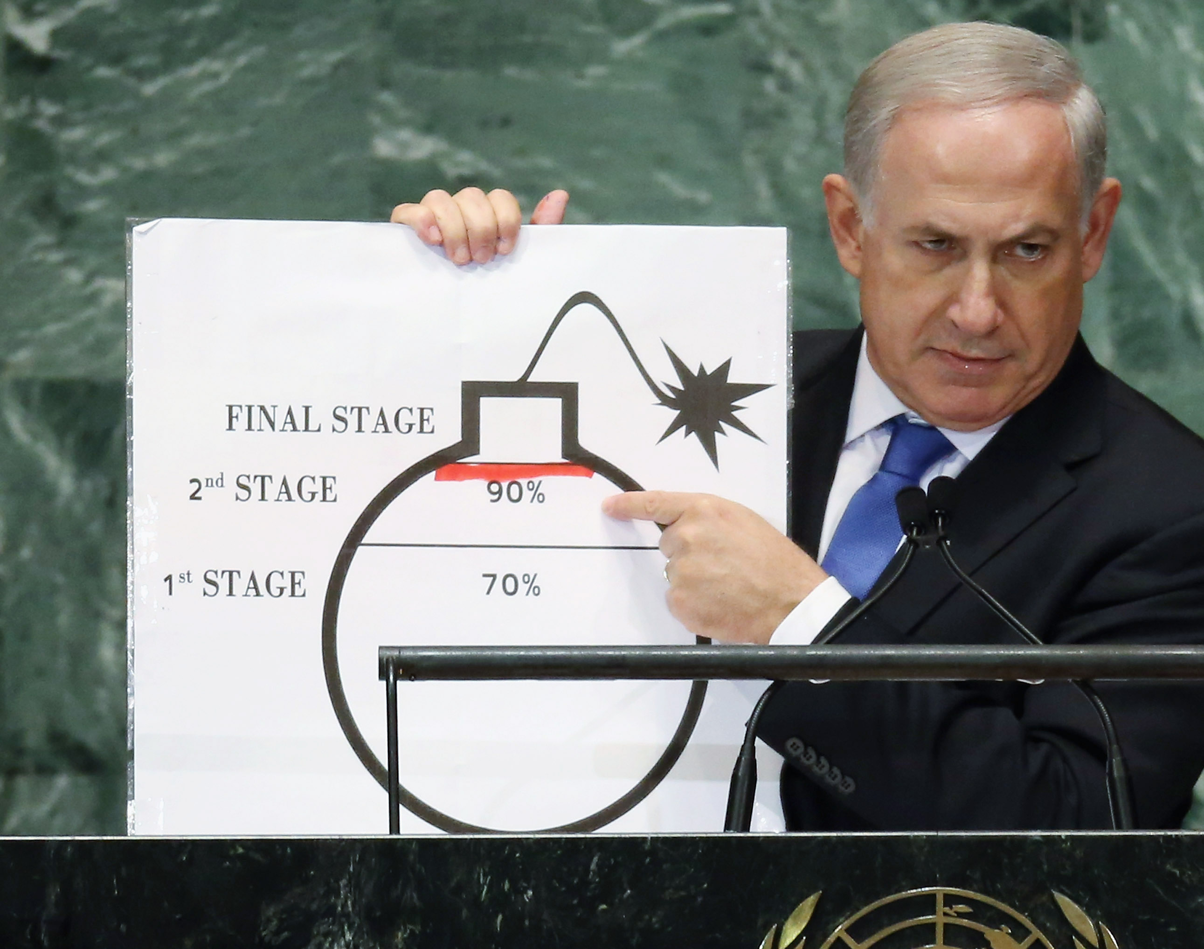
Exploratory data analysis

Slide 15
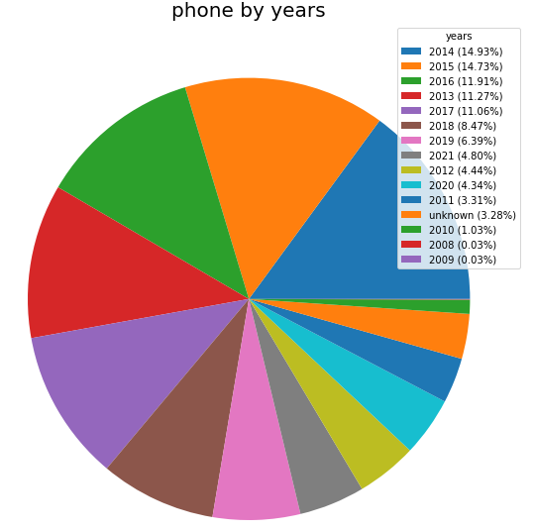
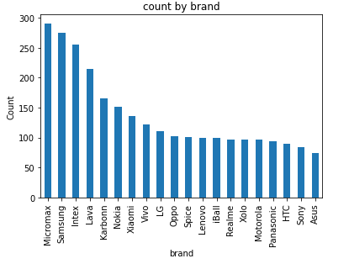
The plot shows us the top 20 companies by the number of phones they released
Visualisation
Except of our research question, we got interested in various properties related to mobile devices: how many models there are in each brand and what is distribution of phones by year.
In this pie plot we can see the distribution of phones by year

Slide 16
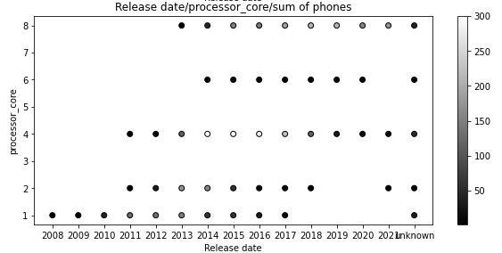
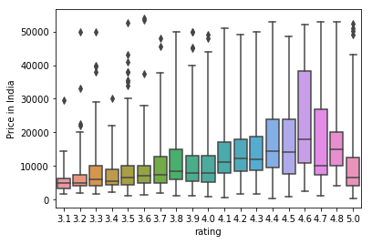
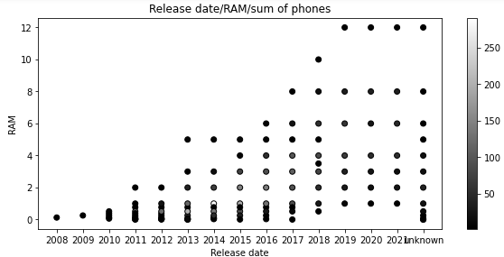
We also interested in distribution of various hardware properties by years, and what is the effect of the price on the user rating
In the first plot we can see the grow of number of processor cores in the device between the years 2008-2013 (from one core to 8 cores).
In addition, we can see that most of the devices produced in the years 2014- 2017 contains 4 cores.
In the second plot we can see linear connection between the release date to the amount of GB RAM , all of that probably happened because the advance of technology year by year
we can see the average price of the phones by the user rating. we saw Increase in the average price by the user rating.

Slide 17
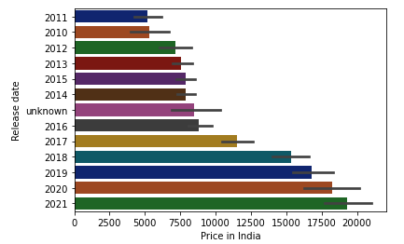
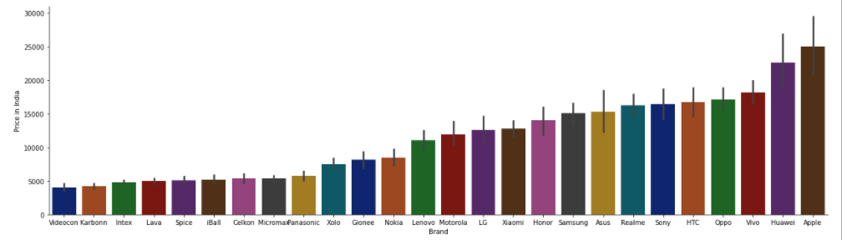
We can see as the years go by the price of phones go up as well.
Apple and Huawei are the most expensive brands by far.

Slide 18
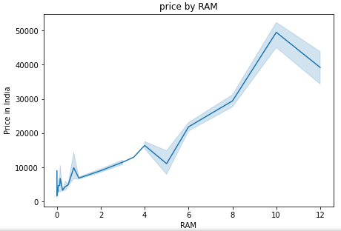
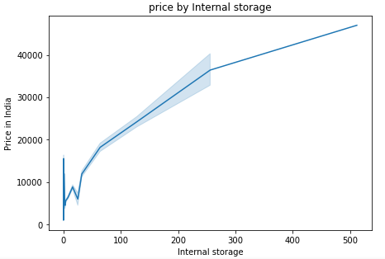
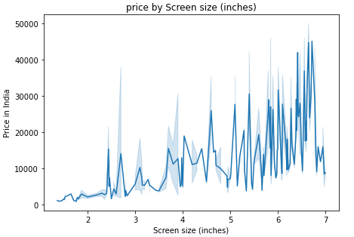
Our research question is if we can predict the price of mobile device by hardware
In those plots we checked the correlation between popular properties to the market price of the mobile device.
In the first 2 plots we can see positive slope that’s mean the price of the device is affected by RAM and internal storage amount.
On the other hand, the last plot shows us there is no visible connection between the price and the screen size of the device

Slide 19
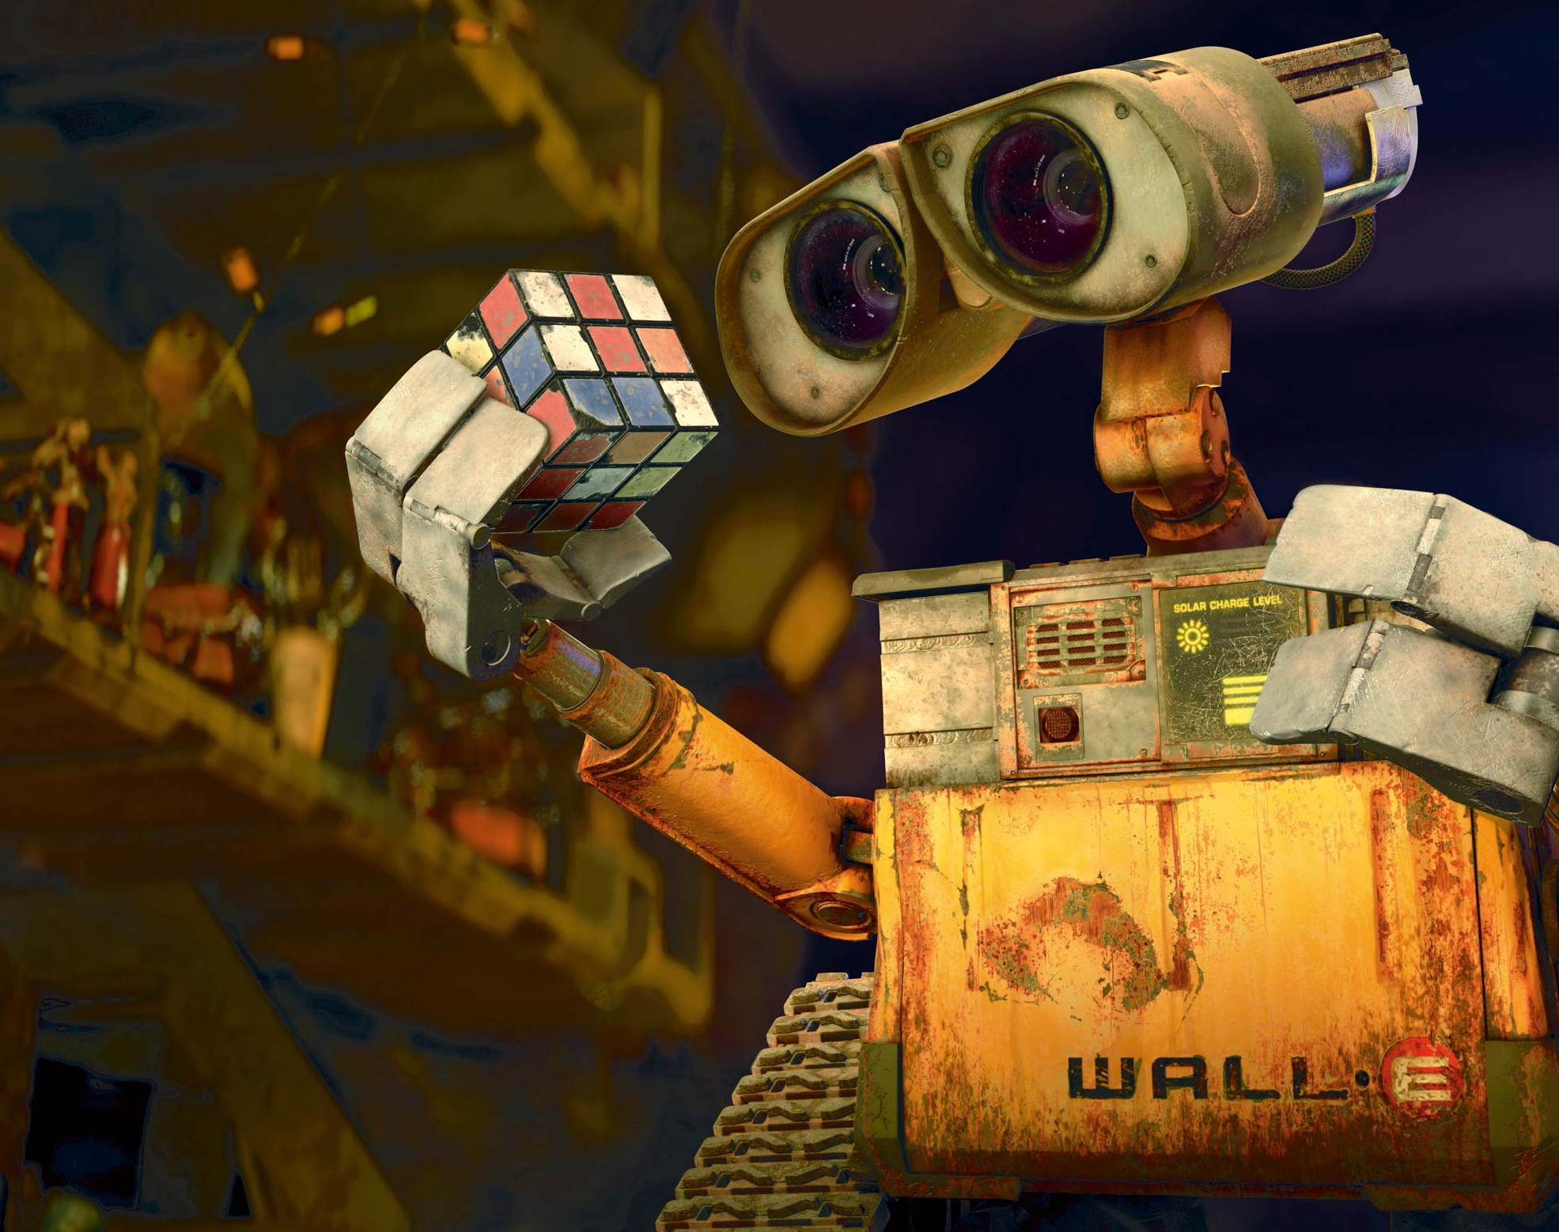
Machine learning

Slide 20
Machine learning
In this section we want to predict the price of the mobile devices using machine learning model.
First some of our data columns was string(brand-(”apple”,”Samsung”…),nfc-(”yes”/”no”),form factor-(”touch screen”,”slider”…). So, we needed to change them to numeric values that can be used in our model.
We decide to choose linear regression and we made function who split the data frame to 4 sections (x_train,y_train,x_test,y_test)and by the train sections return linear model.
We evaluate the results by r2_score and we got 0.59.
We try to improve the score by adding some columns to our data frame. our strategy of adding columns was to make table coefficient and to see what the most affective attributes on our model. we took those and made new columns of multiplication attribute.
After this manipulation we got 0.605 r2_score.
we want to predict price in thousands of rupee and our model mistake in average is about 3500 rupee that translated to 150 Israeli shekel we can afford that kind of mistake.

Slide 21
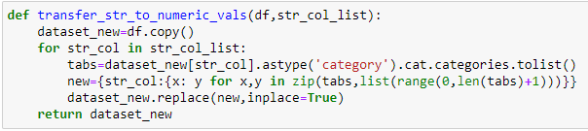
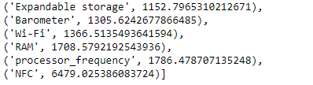
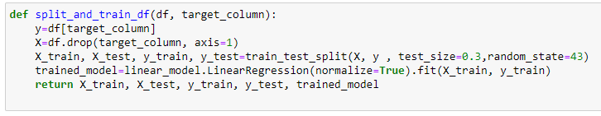
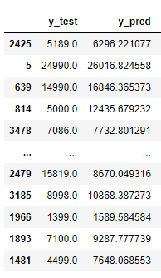
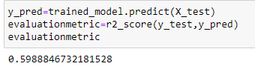
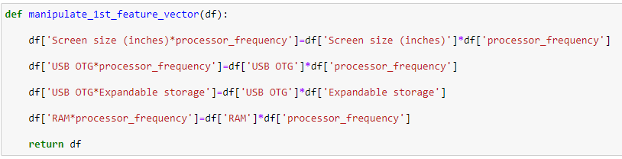
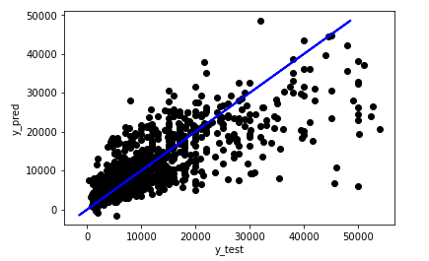
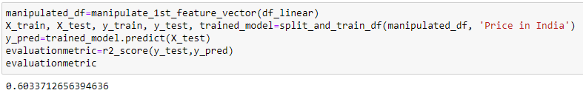

Slide 22
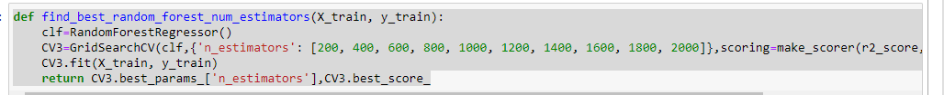
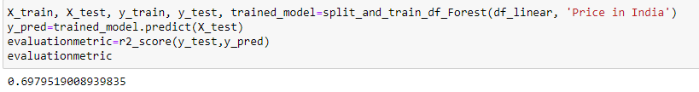
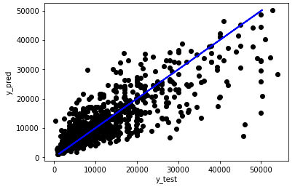
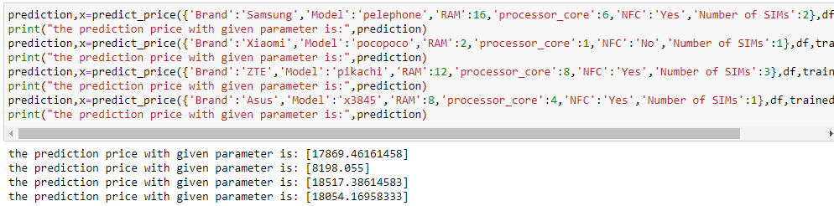
Machine learning
We also tried to use RandomForestRegressor model to get some other evaluation result.
We used CV method to find the best number of estimators parameter to our random forest model.
In this model we got r2_score of 0.7 which is quite better than the linear regression model.
After we created our model, we used it to predict some prices of random phones

Slide 23

Conclusions

Slide 24
Conclusions
As we thought Apple is the most expensive brand of them all.
The number of brands is very high.
Surprising hardware like NFC and Barometer has a big impact on the price,
While screen size and battery capacity doesn’t affect it as much.
The price of mobile phones increase yearly since 2016.
Micromax, Samsung and Intex are the 3 biggest brands in relation to the number of phones released by brand.
So far 2014 is the year with the most phones released.
We can predict quite accurately the price of mobile devices by specifications.

Slide 25

Thank you!

